Slide 1
Visualization of Indian Corporate Networks
SAHIL JINDAL (2013CS10253)
PRAKHAR GUPTA (2013CS10245)

Slide 2
Motivation
Visualizing subset of the Indian Corporate Networks
Displaying network in user friendly way
Highlighting important information in sub-graph
Providing meaning to the steps used to extract the sub-graph

Slide 3
Neo4j
A graph database, data is stored as nodes and edges
Good for visualization and graph based analysis
User Cypher query language, similar to SQL
Storing Companies, Industries and People as Nodes, and others as Edges
Cypher queries to produce useful subsets

Slide 4
Linkurious
A JavaScript library for visualization
Can use a generated graph or a graph imported as a JSON, GEXF, etc
Allows various options for styling, filters and layouts
Usage in project: Display result of a Cypher query on the Neo4j database
Usage in project: Display previously generated graph from stored JSON

Slide 5
Current Progress
Imported data in Neo4j database in batches using python support
Implemented some basic visualizations using Linkurious toolkit
Applied some improvisations on the basic graphs
Size of node proportional to degree of the node
Edge size proportional to its property
Used ForceAtlas layout plugin to get clustered layout of the network
Notes:
Neo4j.v1 library for importing
3. Decide whether to hide nodes with degree less than a certain threshold

Slide 6
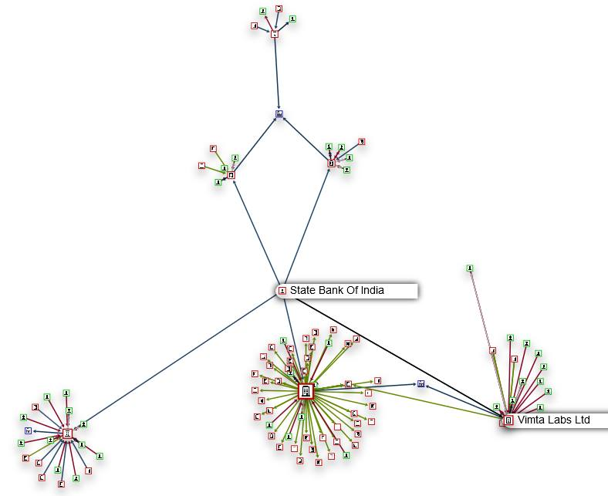
Sample Visualizations
Notes:
match (n:Company)-[r1]-(i:Industry) match (n)-[r2]-(c:Company) match (n)-[r3]-(p:People) return n,r1,i,r2,c,r3,p limit 1000

Slide 7
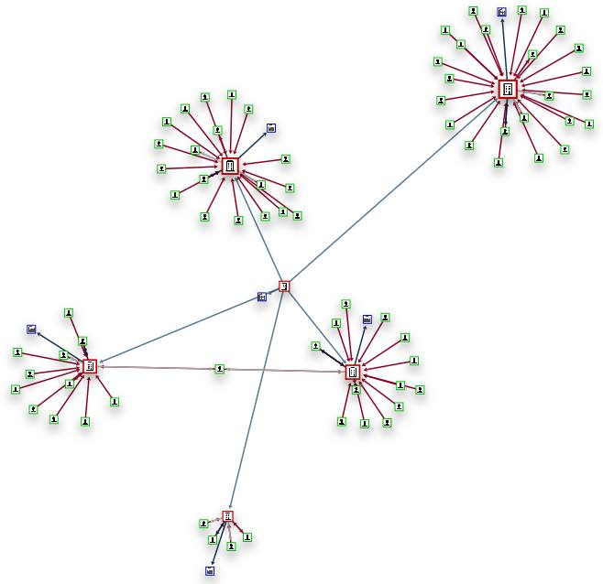
Notes:
match (n:Company)-[r]-(c:Company) match (n)-[r1]-(i:Industry) match (c)-[r2]-(i2:Industry) match (n)-[r3]-(p:People) return n,r,c,r1,i,r2,i2,r3,p limit 100

Slide 8
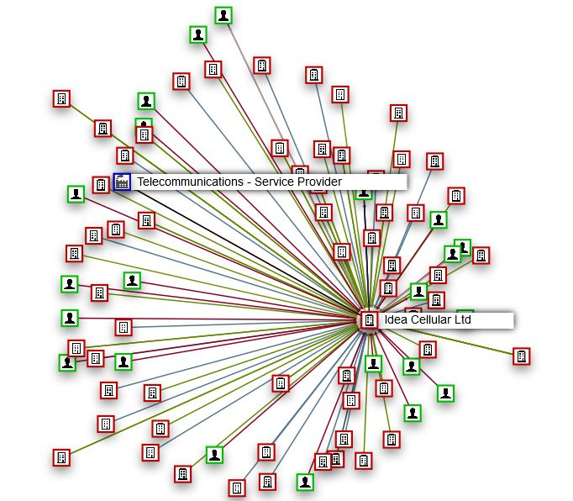
Graph showing connections for Idea Cellular Ltd.
Notes:
MATCH (n:Company{name:"Idea Cellular Ltd"})-[r]-(m) RETURN n,r,m

Slide 9
Further Aim
Sync with analysis team to visualize the analysis patterns
Develop hierarchical model for suitable network sectors
Visualize changes in the Corporate Network over time
View sub-structure corresponding to specific corporate entity
Find connections between entities by obtaining various paths between them
Notes:
Two big companies in the network, visualize any connections if there exist between them
Node with greater value for a property at the top then coming down in this fashion
Subsidiaries emerging over time for a company
As shown in last slide
shortestPath Algorithm in neo4j

Slide 10
Thank You

